Slide 1







DBMS
Lab-3

Slide 2
Things we will complete today
Insert new data into table
Update existing data
Query on single relation
Remove data from table
Query on multiple relation
Quick recap of previous class

Slide 3
Insert new data into table

Slide 4

Insert new data into table
It is possible to write the INSERT INTO statement in two ways.
The first way specifies both the column names and the values to be inserted:

Slide 5
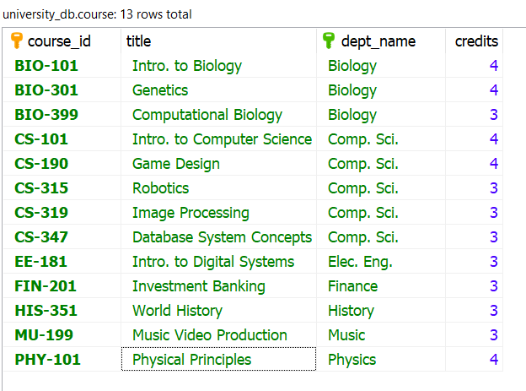



Insert new data into table
Example:

Slide 6


Insert new data into table
If you are adding values for all the columns of the table, you do not need to specify the column names in the SQL query. However, make sure the order of the values is in the same order as the columns in the table.

Slide 7
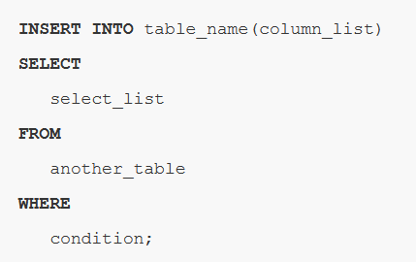
Insert new data from another table
Table1
Table2
Id | FirstName
101 | Adam
102 | Johm
EmployeeId | EmpName
INSERT INTO Table2(EmployeeId,EmployeeName)
SELECT Id,FirstName from Table1;
Table2
EmployeeId | EmpName
101 | Adam
102 | Johm

Slide 8
Update existing data

Slide 9
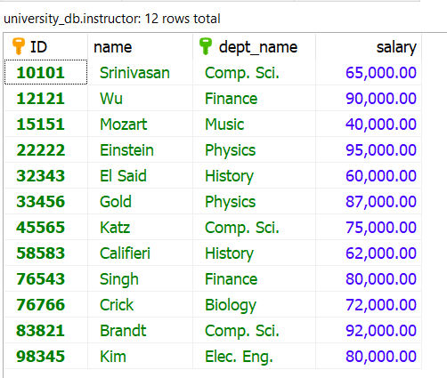


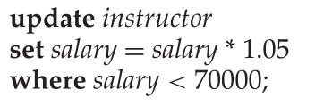
Update Syntax
UPDATE table
SET column1 = expression-1,
column2 = expression-2,
...
[WHERE conditions];
Expression can be a value (eg: 10 , ‘John’) or a
Arithmatic/logical/ string operation resulting in a value
(eg: salary*1.15)

Slide 10
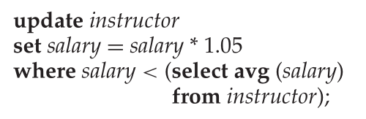
Give a 5 percent salary raise to instructors whose salary is less than average

Slide 11
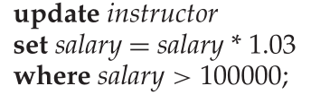
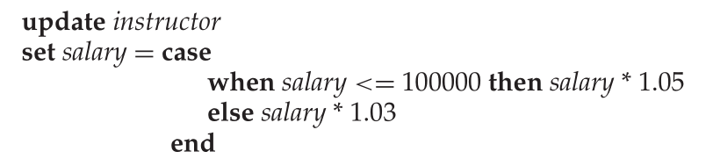
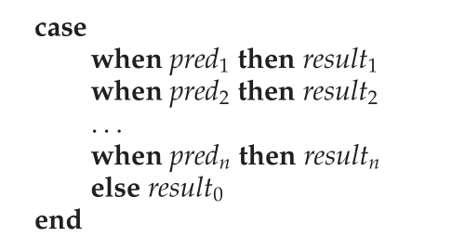
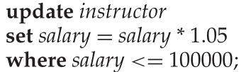
All instructors with salary over $100,000 receive a 3 percent raise, whereas all others receive a 5 percent raise.

Slide 12
Delete data from table

Slide 13

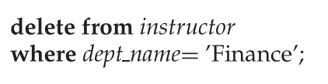
SQL delete statement
We can delete only whole tuples; we cannot delete values on only particular attributes

Slide 14
Queries on a Single Relation

Slide 15
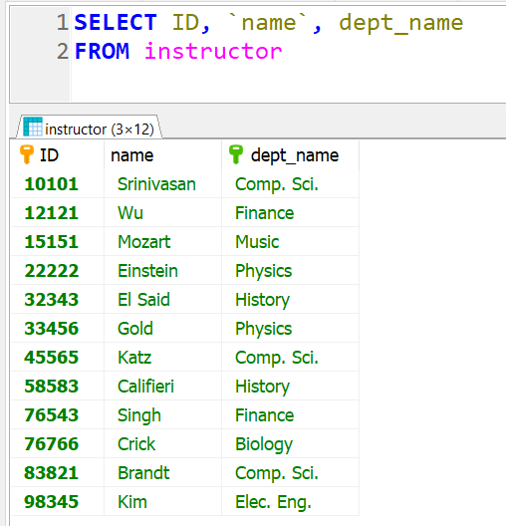
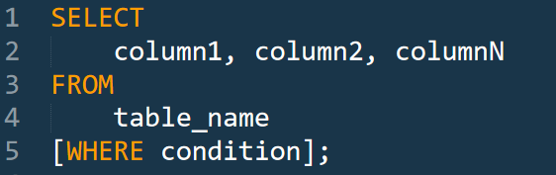
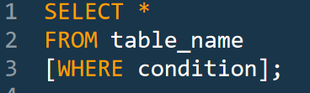
Basic structure of SELECT

Slide 16
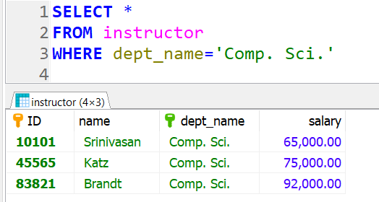
Basic structure of SELECT

Slide 17
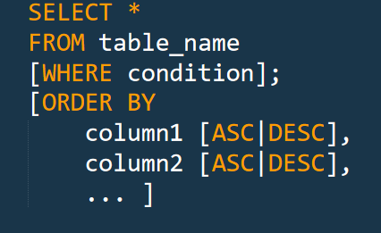
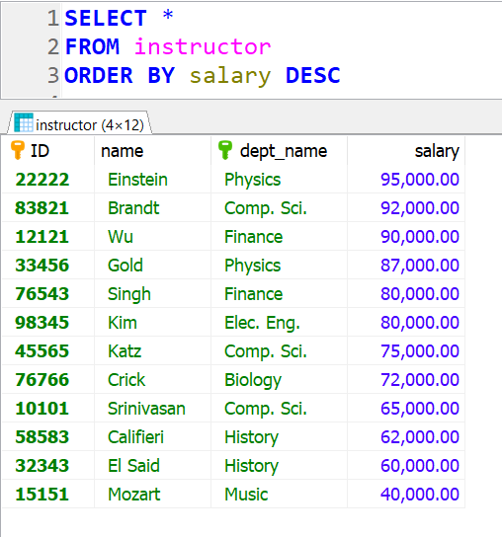
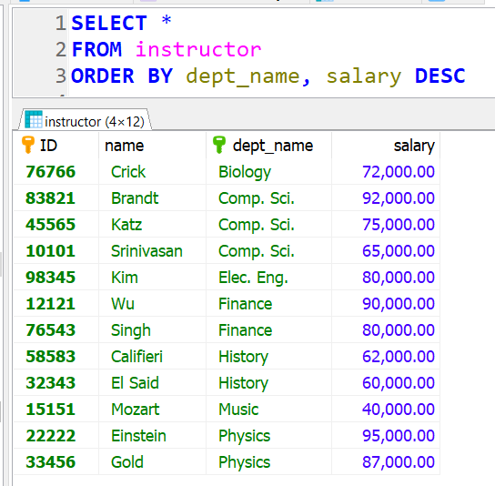
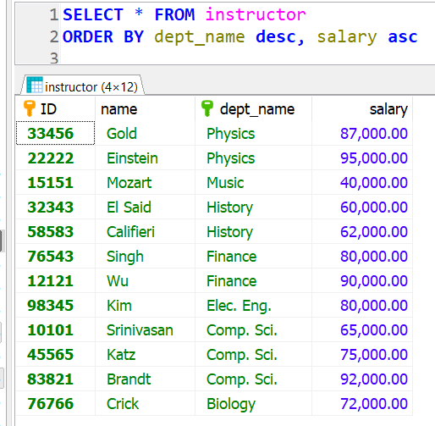
Ordering Result

Slide 18

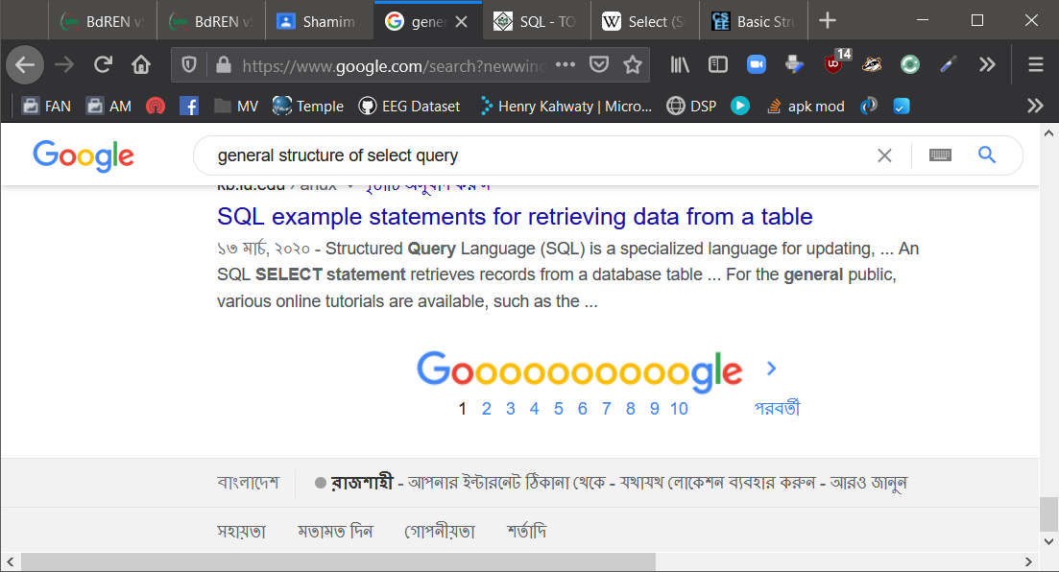
Limiting number or row in output

Slide 19
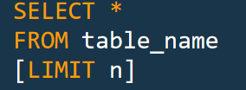
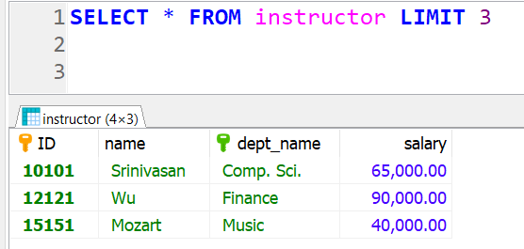
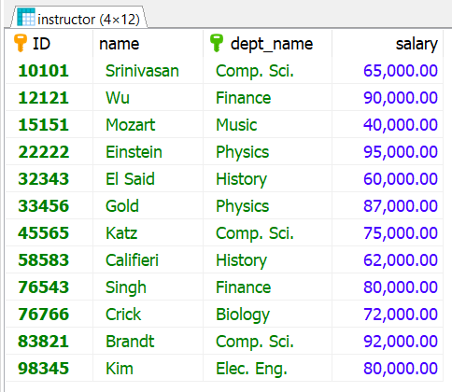
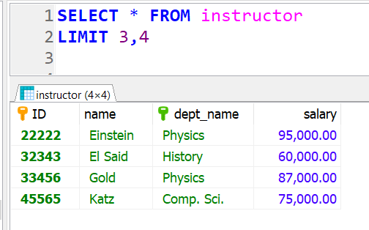
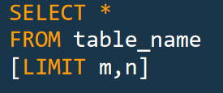
Limiting number or row in output

Slide 20
Demo.

Slide 21
End.

